Slide 1







Name- Arun Kumawat
Projet ID-08
Project Name- Capital Blend
Github link - https://github.com/arunkumawat1404/CapitalBlend
Website link - https://capitalblend-arun-kumawat.netlify.app/

Slide 2




About Project
CapitalBlend is a dynamic online platform that connects investors and entrepreneurs, fostering collaborations and opportunities for mutual growth.
As a private marketing network, CapitalBlend aims to streamline the investment process and facilitate meaningful interactions between investors and business owners. We understand the challenges of navigating the investment landscape and the limited time available for communication. Therefore, our platform acts as a catalyst for efficient and effective collaboration, enabling investors to explore exciting investment prospects and entrepreneurs to showcase their compelling company ideas.

Slide 3


Project Key Features
1.
Easy Investment, Invest in your buisness domain easily , track the record of Investment. Diverse selection of investment opportunities, connecting investors with promising ventures.
2.
Platform to present their business ideas and connect with investors and get funding easily.Seed funding or an existing business seeking expansion capital, our platform can help you access the funding you need to fuel your growth.

Slide 4
3.
Experienced business advisors offers guidance and support to entrepreneurs at every stage of their business journey. From refining business strategies and financial models to improving market positioning and investor pitch decks.
4.
Tools and features that help investors manage their investment portfolio effectively. From tracking investments and monitoring performance to accessing reports and analytics, our portfolio management solutions provide investors with the necessary insights to make informed decisions and optimize their investment strategies.

Slide 5
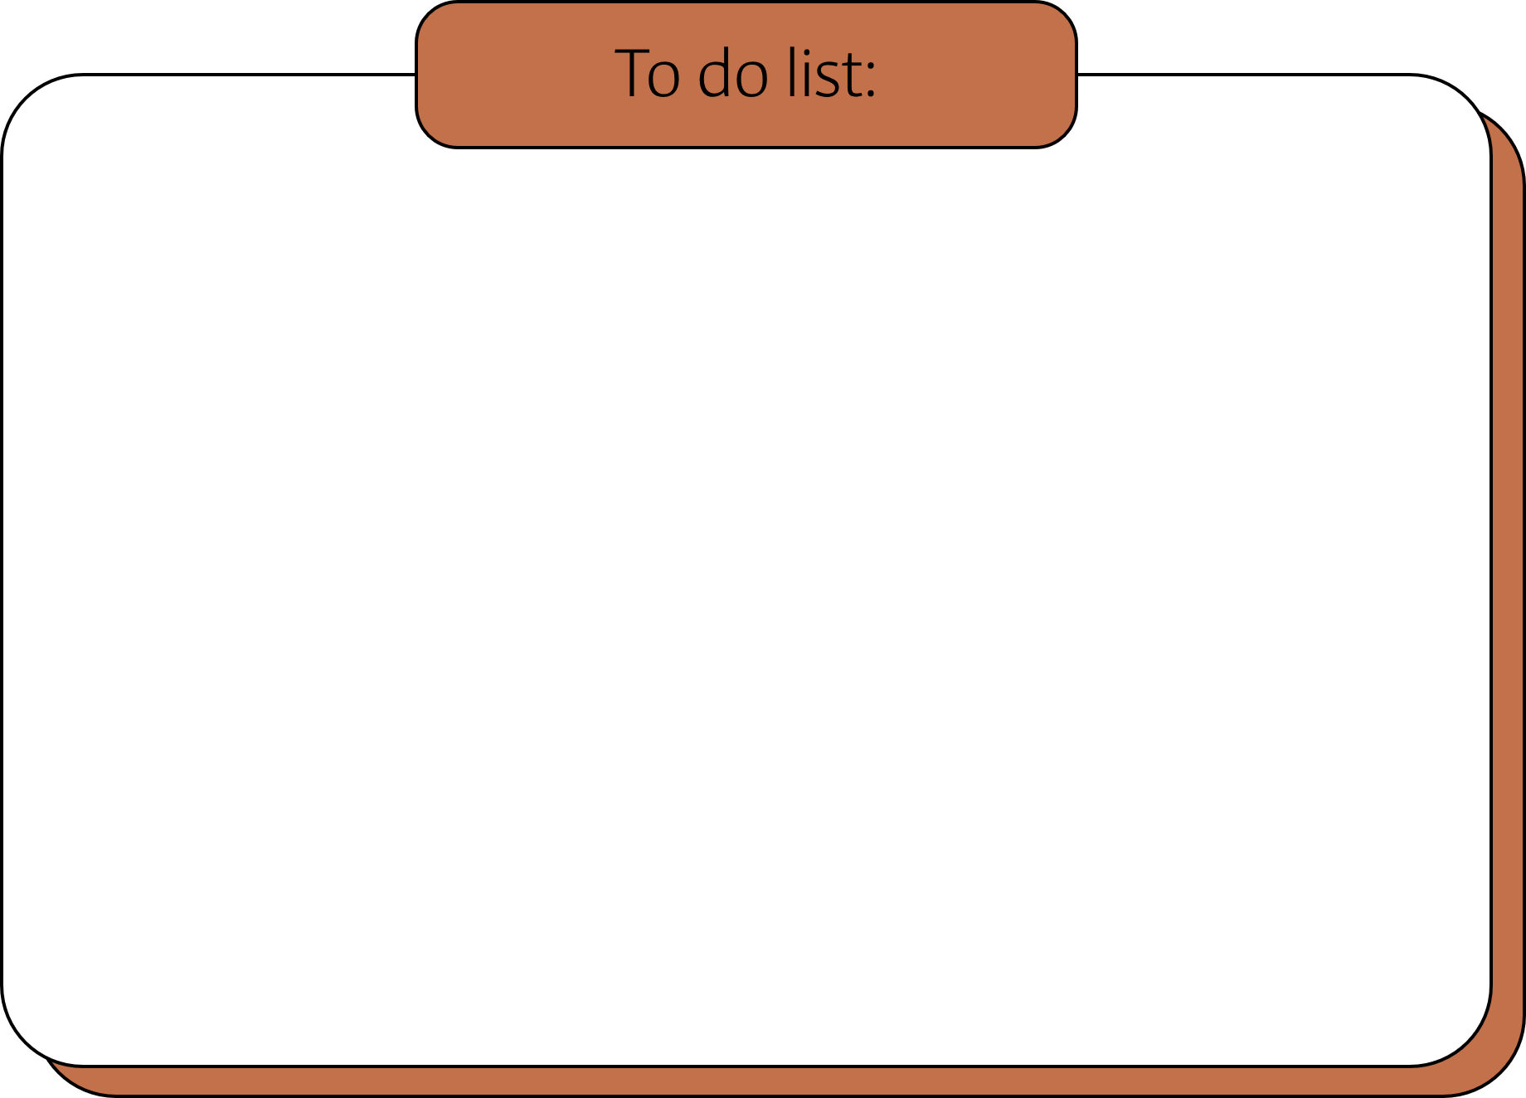
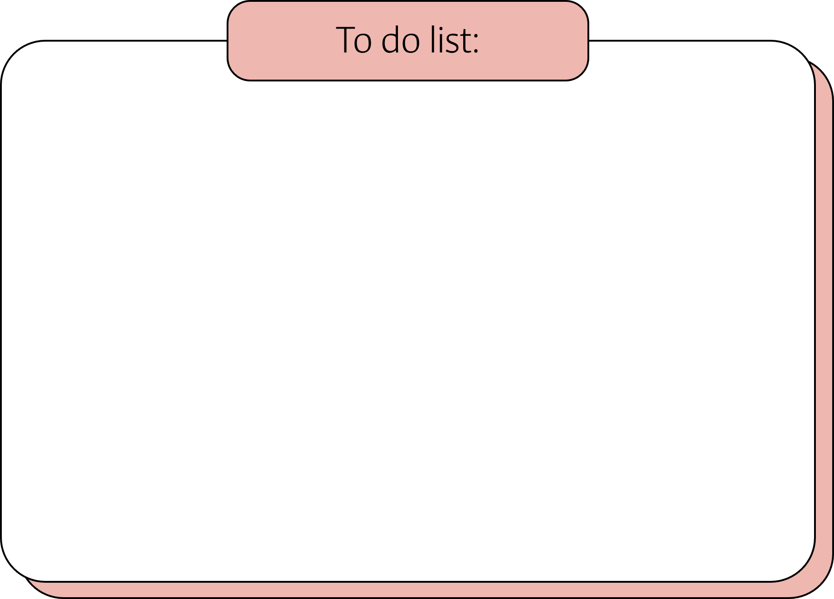
Website Pages
Home
Login/Signup
Home Page
About
Services
Team
Contact
Login
Sign Up
Login / Signup
Buisness People
Investor
Buisness Advisor

Slide 6
Website Pages
Buisness People
Investor
Login/Signup
Home
Profile
Post Idea
Portfolio Managment
Billing
Contact
Logout
Login/Signup
Home
Profile
View Ideas
Portfolio Managment
Billing
Contact
Logout

Slide 7
Website Pages
Buisness Advisor
FireBase Database
Login/Signup
Home
Profile
View Query
Portfolio Managment
Contact
Logout
Store Sign Up information
Autheniticate users by verifing user crediential
Store posted Ideas
Store the contact or communication and act as a chat database storage

Slide 8
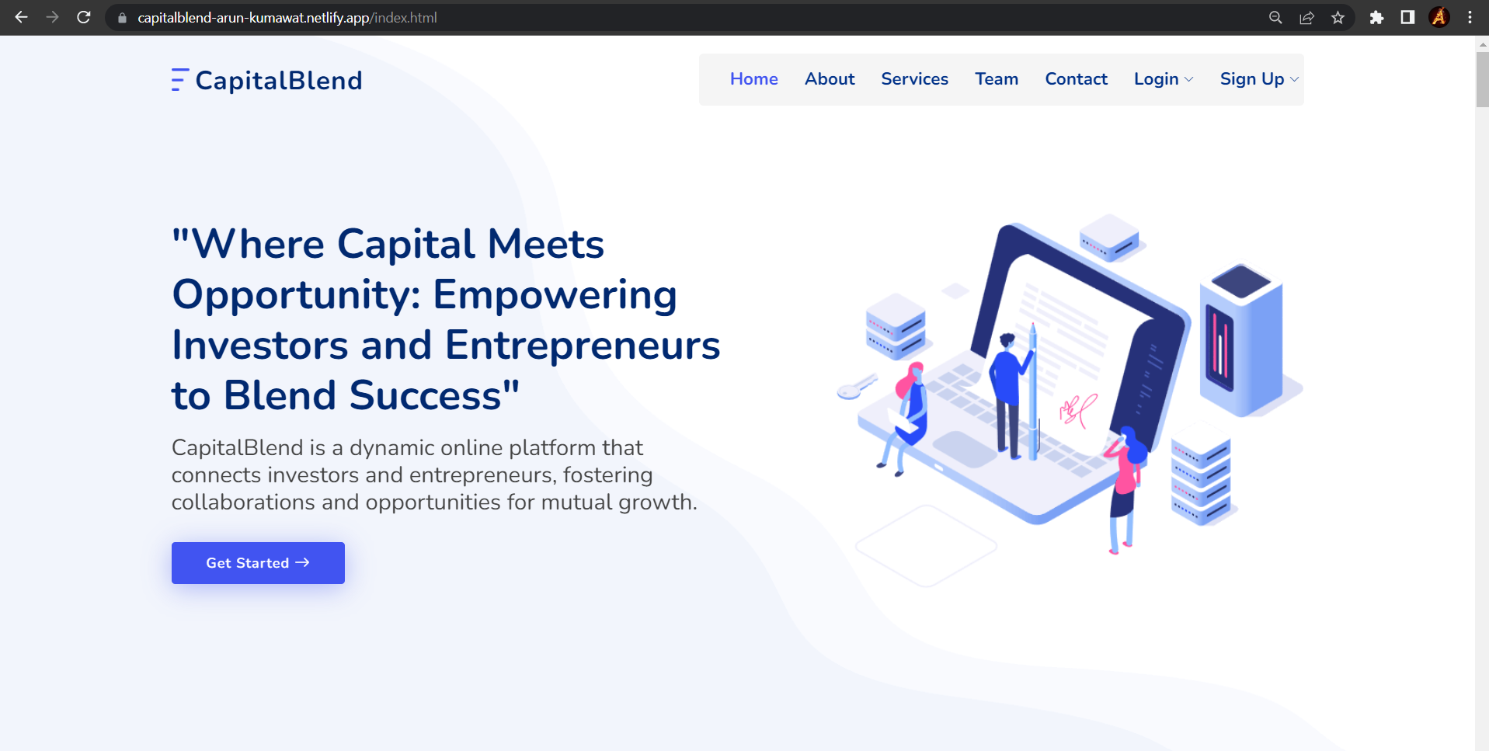
Home Page

Slide 9
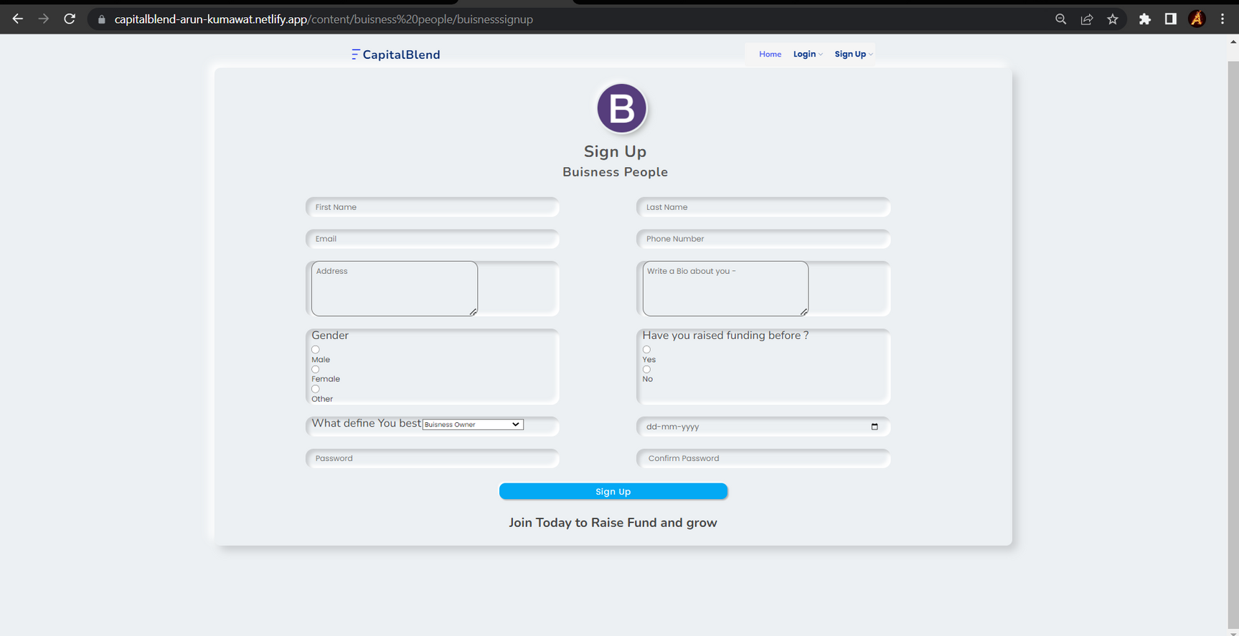
Sign up page for Buisness people

Slide 10
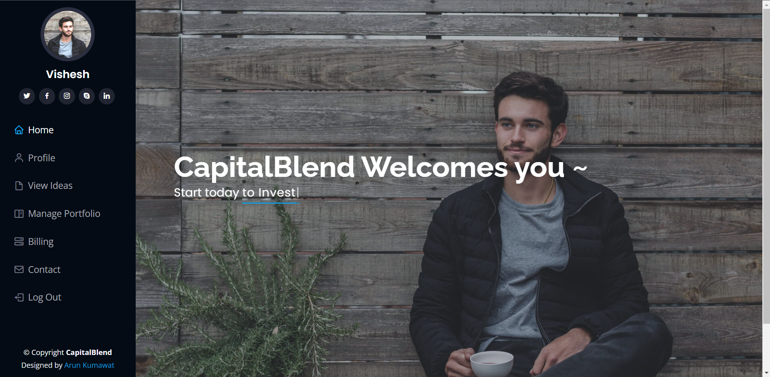
Investor Dashboard

Slide 11
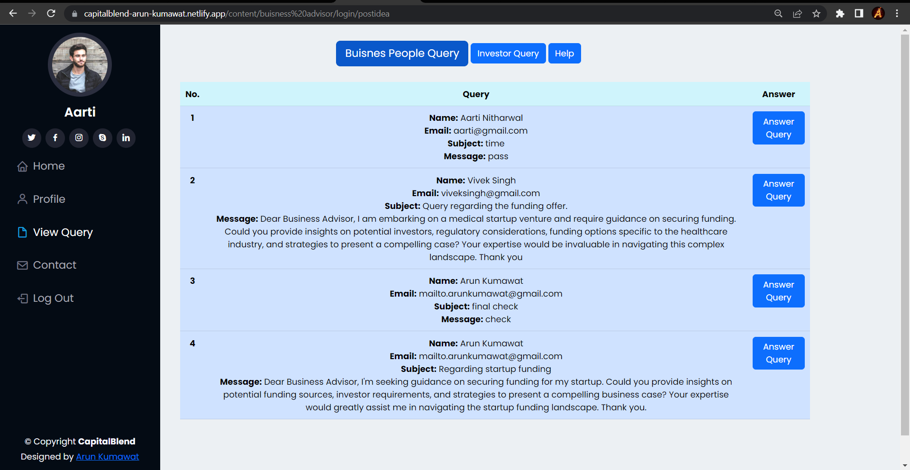
Buisness Adviosr Dashboard for viewing queries

Slide 12







